Slide 1
CC Form104-R

Slide 2
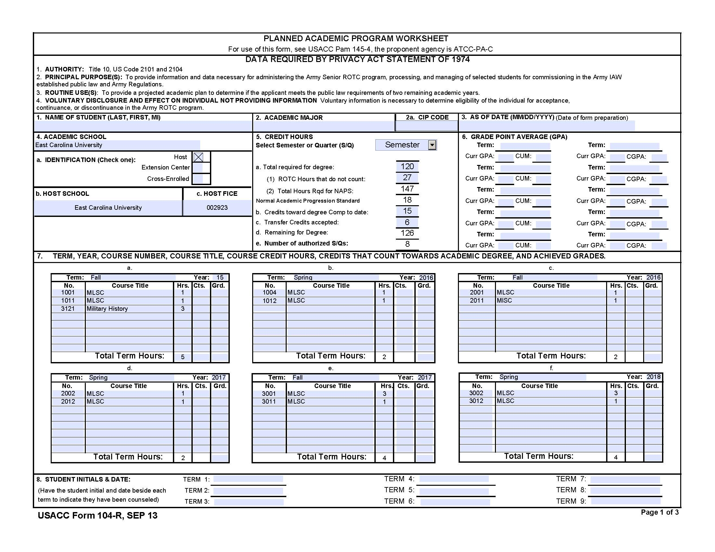

Slide 3
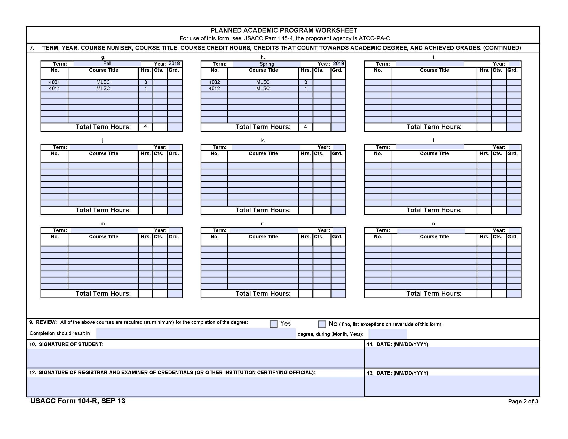

Slide 4
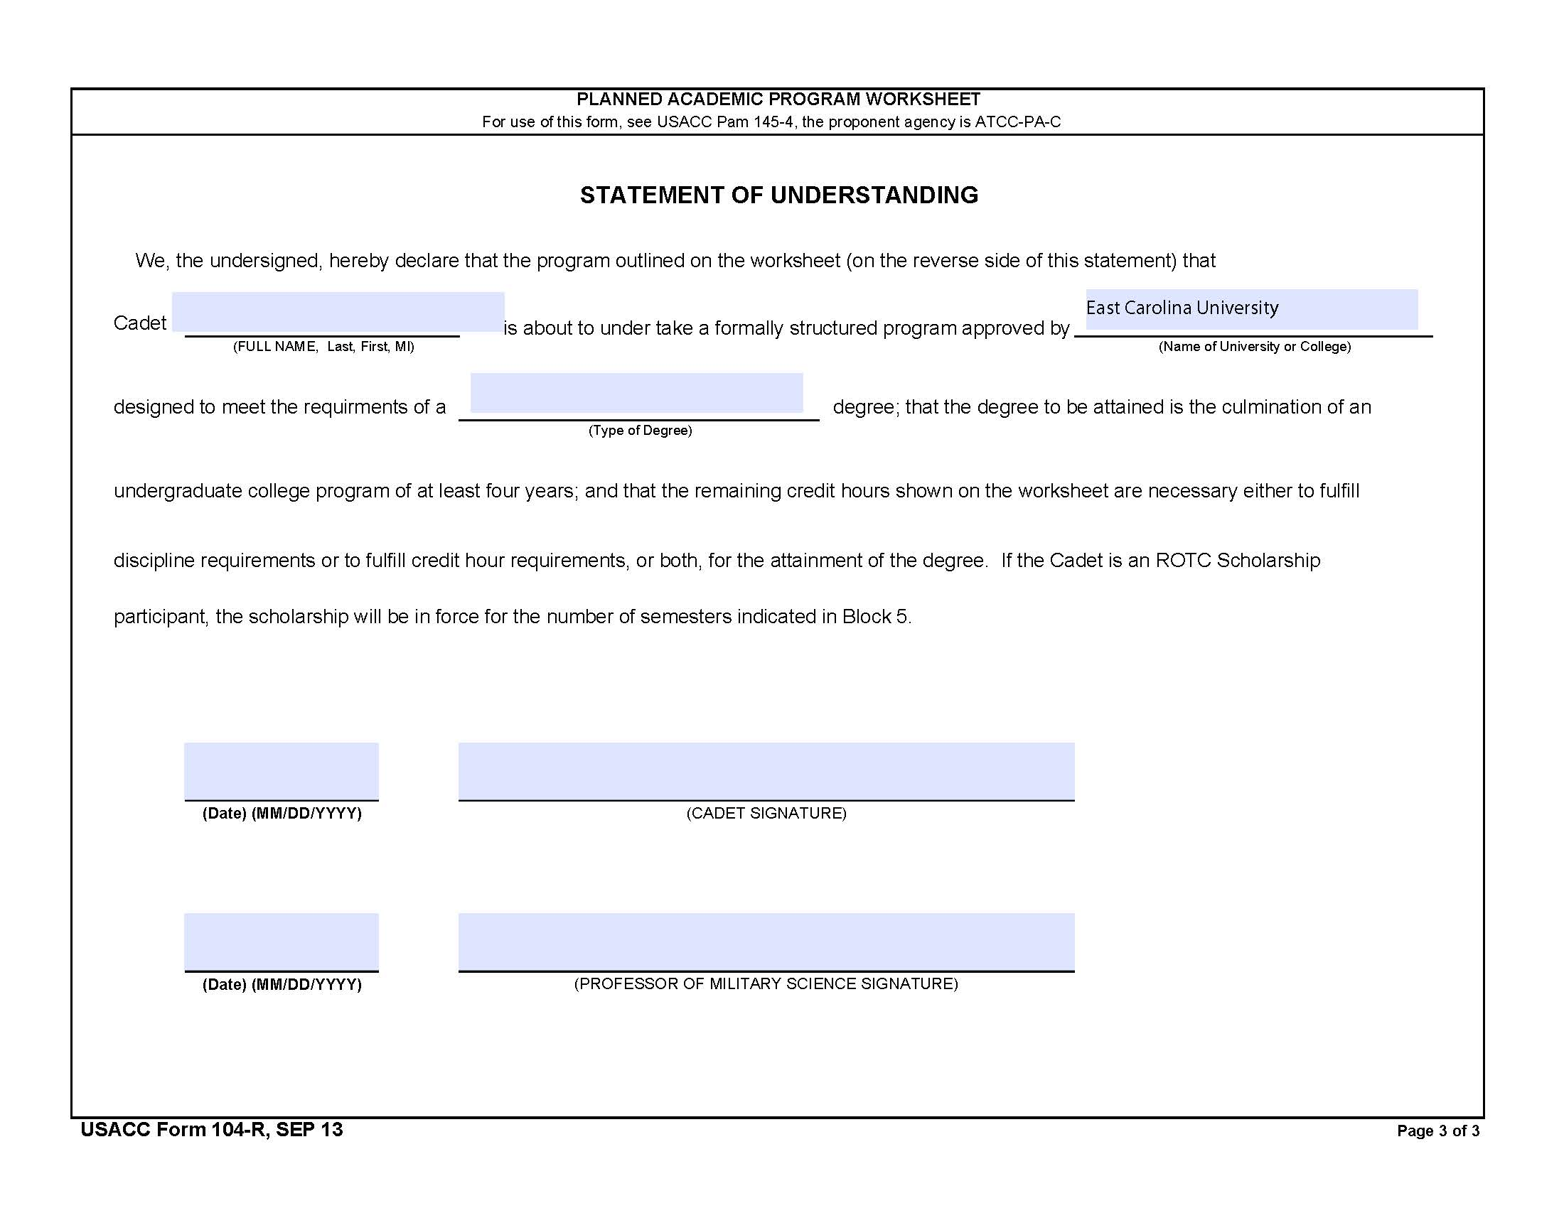

Slide 5
1. Your name
4. “East Carolina University”
4a. “Host”
4b. “East Carolina University”
4c. “002923”

Slide 6
2. List your Major
2a. Leave blank
5. “Semester”
5a. Total number of credit hours needed for your Major
5a(1) Typically 24 or 27. Usually ROTC classes do not count towards your major. Ask your advisor if any ROTC classes can be counted towards a major. The required HIST 3121(2) can often meet a general education requirement. If you have a BA major, ROTC classes can be used towards the military science minor. All BA degrees require a minor.
5a(2) Leave blank
5b. Classes completed at ECU that count towards your degree. Only list credit hours that count towards your degree. Don’t list unrequired electives. Should match block 7.
5c. Classes completed at another institution that count towards your degree. Don’t list classes that don’t count towards your degree. Should match block 7
5d. Automatically calculates the number of credit hours remaining for you degree. Should match block 7

Slide 7
3. Enter the date
6. Each Semester (Term) you will update this form. List the Semester in the “Term:” block. (“Fall 2020”). List the GPA for that semester in the “Curr GPA:” block. List your cumulative GPA in the “CUM:” block.

Slide 8
7. In the “Term” Block list the Semester: Fall, Spring, Summer. List the year: 2020
In the “No.” block list the course number. In the “Course Title” block list the four-letter designator or a short title.
In the “Hrs.” block list the credit hours offered.
When your complete the course, in the “Cts” block, list the number of credits received. If you passed the course, the “Hrs.” block and “Cts.” block should match. In the “Grd.” block list the grade received for the class.
Only list ROTC classes and classes needed towards your major. Do not list unrequired electives.
Your advisor can create a “Calendar-view” degree plan for you in Degree works that should closely resemble this form

Slide 9
8. You should review this form with your instructor each semester and you will initial each semester in the “Term” block when you’ve done so.
After you’ve completed this form your first semester, keep a digital copy. This form will be required EVERY semester, but after the initial complete, or if you have major changes, you can simply update this form each semester.

Slide 10
Page 2
7. Continuation
9. Are only the courses need for your major listed? Yes or No
“Completion should result in” list your major, “during” list your graduation date.
Digitally sign and date.
Your advisor will digitally sign and date.
Note: These signatures attest that to the best of your knowledge and to the best of your advisor’s knowledge, these listed classes, and only these listed classes, are needed for your graduation.
Note:
It is often more convenient for your advisor if you will email this form to them.
It is not your advisor’s job to fill out this form, only review it for correctness. This form should closely resemble the Calendar-view degree plan created in DegreeWorks.

Slide 11
Page 3
List your name in the “Cadet” block.
List ECU in the “university” block.
List your major in the “(Type of Degree)” block.
Sign and date in the “(CADET SIGNATURE)” block.
Your instructor will review and sign the “(PROFESSOR OF MILITARY SCIENCE SIGNATURE) block unless this is the 104R version being used for contracted, then the PMS will sign.

Slide 12
Colleges/Majors
College of Allied Health Sciences/Pre-Professional Advising (Addictions & Rehabilitation Studies; Clinical Laboratory Science; Communication Sciences & Disorders; Health Services & Information Management; and Nutrition Science)
Thomas Harriot College of Arts & Sciences (Anthropology; Biology; Chemistry; Criminal Justice; Economics; English; Foreign Languages and Literatures; Geography, Planning, and Environment; Geology; History; Mathematics; Philosophy & Religious Studies; Physics; Political Science, Psychology; and Sociology)
College of Business (Accounting; Finance; Management; Management Information Systems; Marketing & Supply Chain Management, Miller School of Entrepreneurship; School of Hospitality Leadership)
College of Education (Elementary & Middle Grades; English & History; Math, Science; Special Education) College of Engineering & Technology (Computer Science; Construction Management; Engineering; Technology Systems)
College of Fine Arts & Communication (Art & Design; Communication; Music; Theatre and Dance) College of Health & Human Performance (Health Education & Promotion; Human Development & Family Science; Interior Design & Merchandising; Kinesiology; Recreation Sciences; Social Work)
College of Nursing Honors College
MAP Major Advisement Program (undecided)
https://advising.ecu.edu/advising-centers/

Slide 13
Colleges/Advising Centers
Advising (General) Advising@ecu.edu
Allied Health Sciences/Pre-Professional Advising PPAC@ecu.edu Arts & Sciences (social sciences, humanities, natural sciences, math) THCASadvising@ecu.edu
Business COBadvising@ecu.edu Communication COMMadvising@ecu.edu Education COEadvising@ecu.edu
Engineering & Technology CETadvising@ecu.edu Fine Arts (Theater, Dance) SOTDadvising@ecu.edu Fine Arts (Art) ArtAdvising@ecu.edu
Fine Arts (Music) SOMadvising@ecu.edu
Health & Human Performance HHPadvising@ecu.edu Nursing CONadvising@ecu.edu
Major Advisement (Undecided) MAPadvising@ecu.edu
https://advising.ecu.edu/advising-centers/

Slide 14
Advising Website
https://advising.ecu.edu
Advisor Contact List by major (majors listed in alphabetical order)
Advising Center websites
  Major Information
    How to Choose a major
    Every major & description
    Major requirements (link to undergraduate catalog)
Registering for Classes
General Education
Holds
Registration Instructions (including tutorials)
Common Registration Errors (and how to solve them!)
Tips (math placement, foreign language placement, how to search for general education courses, etc)

Slide 15
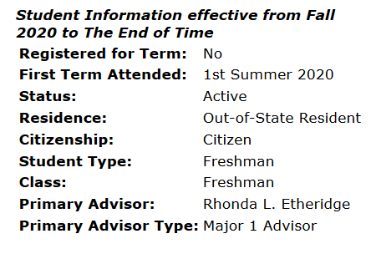
Who Is My Advisor?
When Will I Get An Advisor Assigned?
Who is my advisor?
  Advisors are major specific
  Based on major you listed when signing up for online orientation
When will I get an advisor assigned?
  Advisors assigned after students complete Online Orientation & register for
classes
  Advising Centers will run weekly reports
  Check your ECU email for advisor assignment
  Advisor information can be found in Banner, DegreeWorks, and Pirate Port
  Please be patient

Slide 16
General Education Requirements
English 6 s.h.
ENGL 1100 (WI) to be taken during 1st year; ENGL 2201 (WI) to be taken during 2nd year Social Sciences 9 s.h. (with at least 1 course from 2 different disciplines such as Anthropology, Geography, Political Science, Psychology, Sociology, etc)
Natural Sciences 7 s.h. (and at least 1 of them must contain a LAB such as Biology, Chemistry, Geology, Physics)
Math 3 s.h.
Health 1000 2 s.h. and KINE 1000 or 1001 1 or 2 s.h.
Humanities and Fine Arts 9 s.h. (at least 1 Humanities and 1 Fine Art)
Humanities include Literature, Religion, Philosophy Fine Arts include Art, Music, Theater, Dance, Creative Writing
ADDITIONAL General Ed course (any category) 3 s.h.
*Must complete at least one GLOBAL DIVERSITY (GD) course
*Must complete at least one DOMESTIC DIVERSITY (DD) course
*Must complete at least 12 hours of WRITING INTENSIVE (WI) courses
Total: 40 hours
(Your MAJOR CAN count towards your general education requirement)

Slide 17
I’m Bringing In Early College Credit. . .
Email Advising@ecu.edu (from your ECU email account) with your
Banner ID (B0xxxxxx), Intended Major, and list of courses you’ve completed
& where you have taken them (screenshot/PDF of unofficial college transcript is fine)
To Receive Credit, You Must Send An OFFICIAL COLLEGE TRANSCRIPT Office of Undergraduate Admissions
Mail Stop 517
East Carolina University Greenville, NC 27858-4353
We also accept electronic transcripts from most transcript services including the College Foundation of North Carolina (CFNC). Please request to have them sent directly to admissions@ecu.edu.
Advanced Placement Credit
Scores should be received by mid July from College Board
https://admissions.ecu.edu/placement-credit/

Slide 18
Schedule Basics
Most of your fall schedule will consist of General Education requirements (and maybe 1-2 major courses)
  Early college credit opens the door to exploring double majors or minors
Course designations (can take one level above)
  0001-0999 Remedial (example: MATH 0001, MATH 0045; do not earn college credit)
  1000 level Freshmen (ENGL 1100, HIST 1030, PSYC 1000)
  2000 level Sophomore (ANTH 2000, ECON 2113, SOCI 2110)
  3000 level Junior
  4000 level Senior
Most degree plans require 120 hours to graduate (30-60-90-120)
  Freshmen 0-29 hours
  Sophomore = 30 -59 hours
  Junior = 60 -89 hours
  Senior = 90+ hours

Slide 19

Course Load
The typical course load per semester
  14-16 hours (Finish in Four Years)
  Most courses are 3 s.h. but some courses may be 1 or 2 (Science labs, Health, Kinesiology)
What is considered full-time?
  12-18 How much/little you take, is up to you and your comfort level
  If you are bringing in college credit already, you can afford to take a lighter load of 12 hours in fall to get adjusted to college.
  Do not assume you can graduate in 2 years if you are bringing in an associate’s degree (60 hours) because it will depend on how far along you are in your major courses.

Slide 20
Mr. Anderson
andersondal@ecu.edu
252-622-5346

